Slide 1
Human Sexuality (introduction )

Slide 2
Introduction
What is Human Sexuality
Why do we want to learn human sexuality

Slide 3
What is Human Sexuality
“Human sexuality is the perception of being male or female and all those thoughts, feeling and behaviors connected with sexual gratification and reproduction including the attraction of one person to another.”
Sexuality is determined by anatomy, physiology, psychology, the culture in which one lives, one’s relationships with others, and developmental experiences throughout the life cycle

Slide 4
Sexual Health: World Health Organization definition
“ A capacity to enjoy and control sexual behavior in accordance with a social and personal ethic; freedom from fear , shame, guilt, false beliefs, and other psychological factors inhibiting sexual response and impairing sexual relationships: freedom from organic disorders, disease, and deficiencies that interfere with sexual and reproductive functions”

Slide 5
Sexuality
Is express through interactions and relationships with people of the apposite sex or the same sex and includes a persons thoughts, experiences, learnings, ideas, values, fantasies and emotions
How generally people feel about themselves and how they communicate those feeling to others
Gestures, mannerisms, dress and vocabulary (subtle)
touchng,kissing,hugging,sexual intercourse (overt)

Slide 6
Sexuality has four aspects
1.sexual identity
2.Gender identity
3 sexual orientation
4.Expression of feelings

Slide 7
1.Sexual Identity
The pattern of person's biological sexual characteristics,includes chromasomal make up,gonads and hormones,external genitalia
2.Gender Identity
Person's sense of being male or female
Usually by age 2 or 3,people have sense of male vs female
Is affected by many cultural and social cues
3.Sexual Orientation
A description of which sex a person is attracted to
Hetarosexual,homosexual,bisexual
In US,about 3%of men and 1.5%women identify themselves as exclusively homosexual
Unclear studies for bisexuality
4.Expression of sexual feelings
Sexual response
Type of object of pleasure involved
Type of pleasurable activity

Slide 8
Physical development
Genetically programmed for female sex
Bipotential tissues
Gonads and ducts-gonadal sex
Genital tubercle,urethral folds,urethral groove and labioscrotal swellings - phenotypic sex
Gonad - testis or ovary
Wolffian duct - vas deferens
Mullerian duct - oviduct

Slide 9
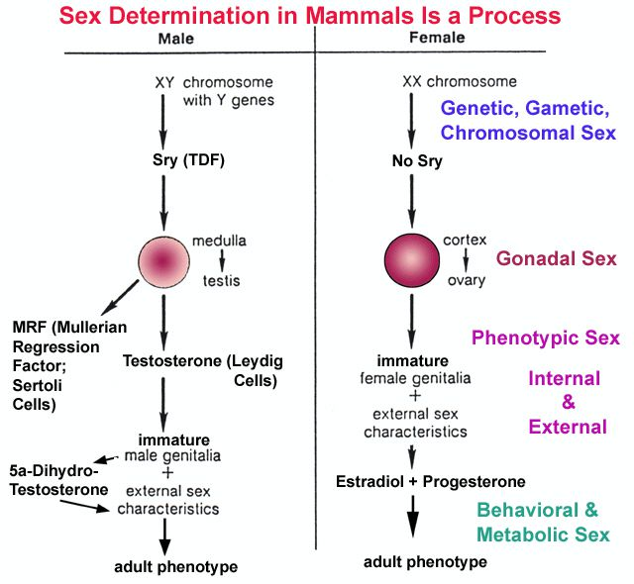
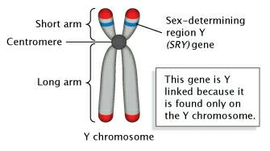

Slide 10
Physical development
Gonads-(become) - Testes or Ovaries
In males, at 7th week,outer portions of gonads degenerate and inner portions develop into testes
In female, at 11th week, inner portions of gonads degenarate and outer portions develop into ovaries

Slide 11
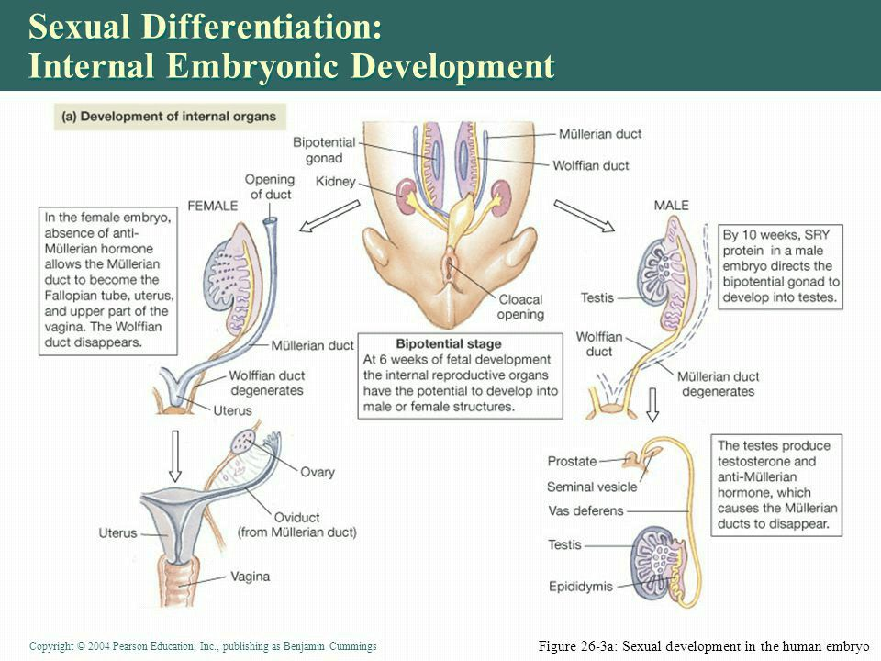

Slide 12
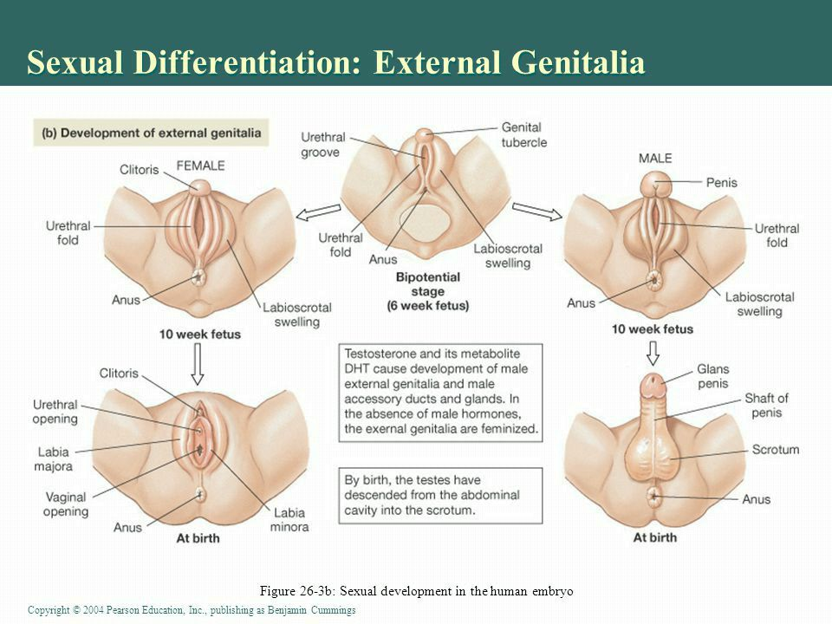

Slide 13
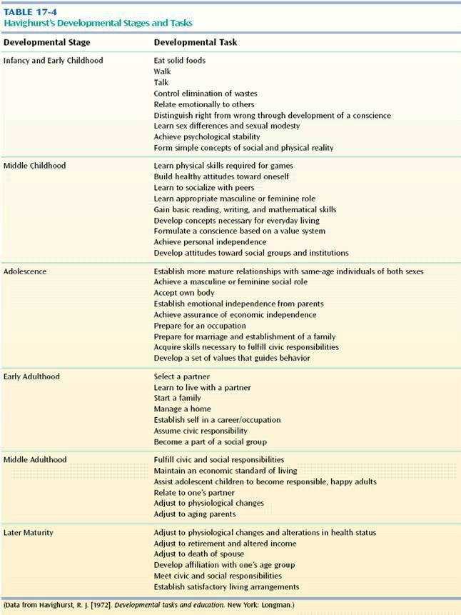

Slide 14
Adolescence
Puberty
Period of rapid physical growth and sexual maturation
Brings person close to adult size, shape, and sexual potential
Onset triggered by chain of hormonal events started by leptin
Leptin Hormone produced in fat cells
Stimulate hypothalamus

Slide 15
Timing of puberty
Normal range ages 8-14
Body changes 1-2yrs earlier for girls
Secular trend
Tendancy of successive generations to develop differently because of changes in nutrition and health care
Age of puberty now earlier than in previous generations

Slide 16
GnRH: gonad releasing hormone
Stimulates ovaries and testes
Testosterone increases 18 times childhood level in males
Estrogen increases 8 times childhood level in females
Each sex has lesser increases of the other hormone
Release of testosterone and estrogen triggers release of GH (growth hormone ),leading to growth spurts

Slide 17
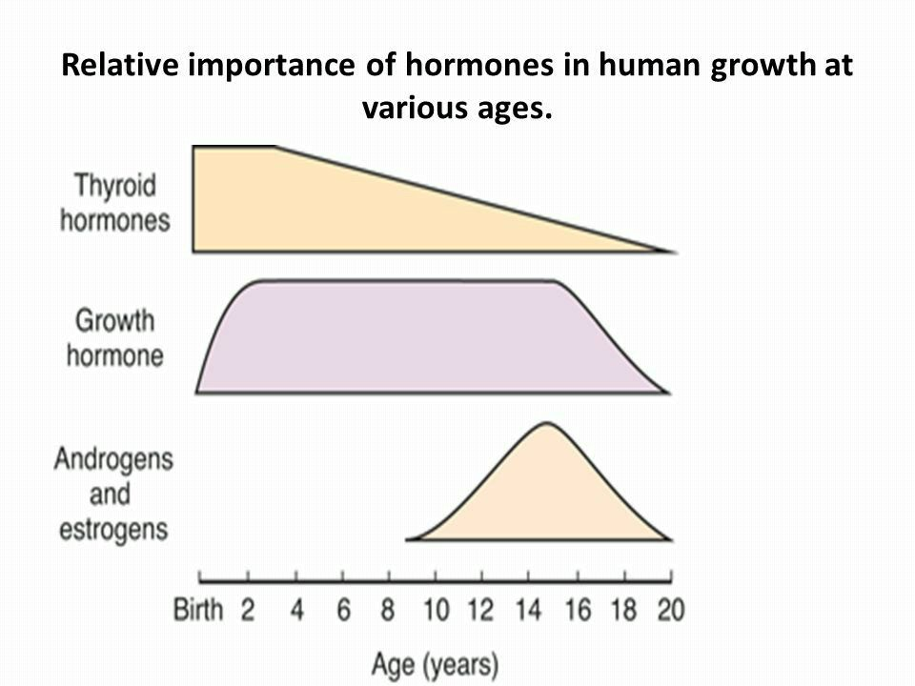

Slide 18
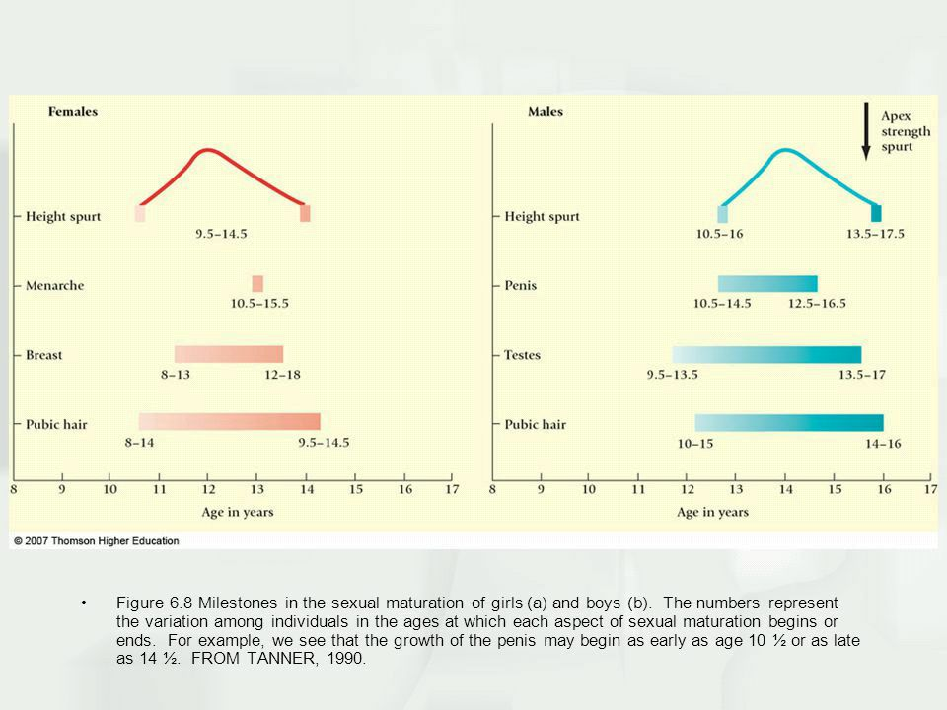

Slide 19
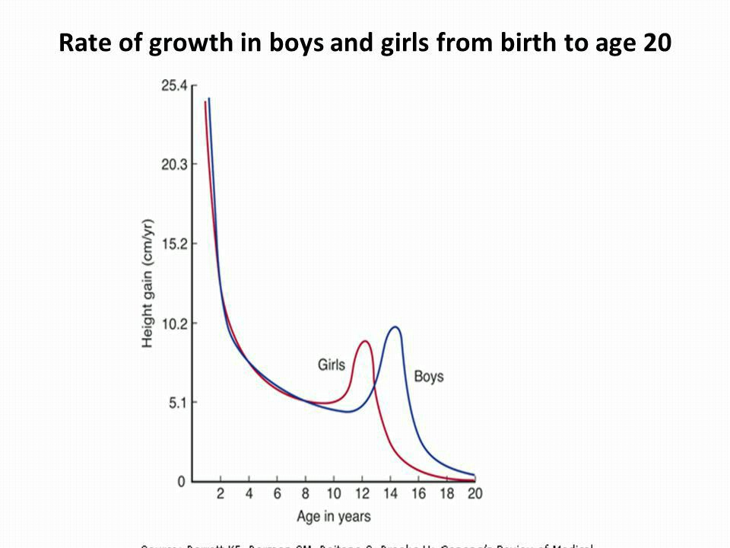

Slide 20
Growth spurts
Distal-Proximal growth pattern
Torso last to grow
Ears,lips,nose enlarge before head takes final shape and size
Spurt in oder of weight,height,then muscles and organs
Growth may initially be more asymmetrical

Slide 21
Physical growth
sequential changes usually
Bone growth before muscular
Grow in length and neck first
Hands and feet apper large for child
Hip and chest growth occurs then shoulder width
Next the trunk and depth of chest change
Long legged,gawky appearance

Slide 22
Physical growth
Eyeballs elongate: some become myopic oil,sweat and odor glands become more active
85%have some degree of acne

Slide 23
Sexual maturation
Primary sex characteristics
Involves organs directly involved in reproduction
These organs enlarge early in puberty
Milestones indicative of reproductive possibility
Menarche in girls: first menstrual period (first cycles usually anovulatory)
Spermarche in boys : first ejaculation of sperm containing fluid (sperm counts low at first)
Fertility gradually increases

Slide 24
Secoundary sexual characteristics
signs of sexual development
Not directly related to reproduction
Body shape,facial and bodh hair
Breast development
Not just girls
65%boys have temporary breast enlargement around age 14

Slide 25
Sexual maturation
visible changes apper in orderly sequence
Ages vary when changes apper
Tanner stages serves as guide to estimating sexual maturity
Based on development of secondary sexual characteristics and genital development

Slide 26
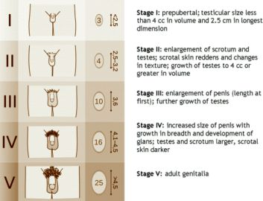

Slide 27
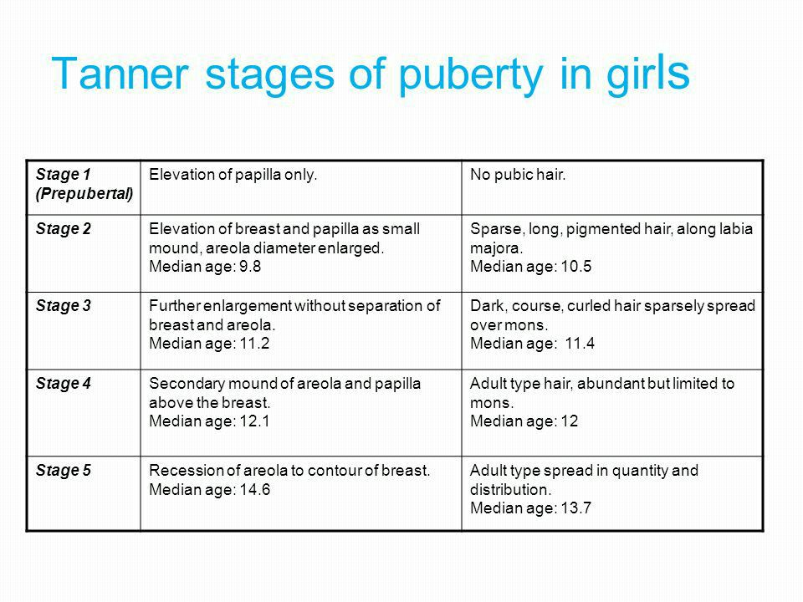

Slide 28
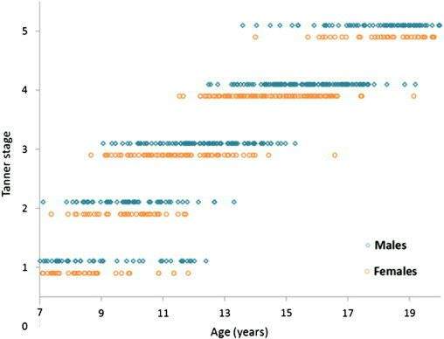

Slide 29
Psychosexual development Freud
In general,stated children move through stages,where their can be conflicts,between biological drives and social expectations
Theorised 5 stages of psychosexual development
0-18months - oral stage where inherent biological drives predominant
18months - 3years - anal stage where child begins control over drives (eg.toilet training)
3-6 - phallic stage where genitals become areas of focus,oedipal and electra complex

Slide 30
Sexual development
4.6-11 - latancy stage where sexual impulses slow and conscience become prominent
5.11-19 - Genital stage where sexual activity increases

Slide 32
Oral stage of development
Birth to 18 months
Erogenous zone is mouth
Gratification through sucking and swallowing
Oral fixation has two possible outcomes

Slide 33
Oral receptive personality
Preoccupied with eating/drinking
Reduce tension through oral activity
(eating , drinking, smoking, biting nails)
Passive and needy; sensitive to rejection
Oral aggressive personality
Hostile and verbally abusive to others

Slide 34
Anal stage of development
1 1/2 to 3 years`
Erogenous zone is anus
Conflict surrounds toilet training
Anal fixationhas 2 possible outcomes
Anal retentive personality
Stingy,compulsive orderliness,stubborn,perfectionist
Anal expulsive personality
Lack of self control,messy,careless

Slide 35
Phallic stage of development
3 to 6 years
Erogenous zone is genitals : self stimulation of genitals produce pleasure
At the age 5or 6, near the end of the phallic stage,children experience the
Oedipal Conflict (boys)
Electra comflict ( girls)
A process through which they learns to identify with the same gender parent by acting as much like that parent as possible

Slide 36
Oedipus complex vs electra complex
Child is sexually attracted to the other sex parent and whishes to replace the same sex parent

Slide 37
Oedipus complex (little boys)
Castration anxiety :
Son belives father knows about his desire for mom
Fear father will castrate him
Represses his desire defensively identifies with dad

Slide 38
Electra complex (little girls)
Penis envy
Daughter is initially attached to mother
Shift of attachment occur when she realises she lacks a penis
She desires dad whom she sees as a means to obtain a penis substitute (a child )
Represses her desire for dad
Incoperate the values of her mother
Accepts her inherent inferiority in society

Slide 39
Latency period
Little girls and little boys try to socialise onlh with members of their own gender
Freud points that children do this so as to help minimise the awareness of sexuality
Thus,they continue the process of sexual repression that began in previous stage
For those who successfully made it through the oedipus complex/electra complex

Slide 40
Genital stage
When adolescence befin puberty,they enter the 5th stage of psychosexual development
They develop secoundary sexual characteristics
The onset of the physical sexual characteristics re-awakens people sexual urges,thus they are no longer able to successfully repress their sexual desires,impulses,and urges
They begin searching for a marital mate,with whome they can share sex and intimacy

Slide 41
Puberty -Early Adolescence special characteristics of boys
Boys in puberty gain more weight and height than girls
Much talk about sex and girls
Out of house more and more

Slide 42
Puberty -Early Adolescence special characteristics of Girls
Vague and diffuse
Crush on older men
Interested in romantic love
Playacting
Giggly

Slide 43
Early Adolescence
Boys express their sexuality through masturbation
Same gender sexual encounters are relatively uncommon
These occur frequently enough to be considered as a variant of normal sexual development

Slide 44
Middle Adolescence
Often the greatest experimental,risk taking time
Drinking,drugs,smoking and sexual experimentation are often of the highest interest to those between 12 and 16 years
This is when first intercourse,first drink,or first pregnancy occur

Slide 45
Middle Adolescence
Sexual development results in unpredictable surges in sexual drive
This is accompanied by unavoidable sexual fantasies and impulses
Sexuality is the MAJOR preoccupation of the middle adolescent

Slide 46
Middle Adolescence
Sexual activity occurs more frequently among boys than girls
Possibly because,
Females less likely to discover sexual responses spontaneously because their sexual organs are less prominent and less subject to manipulation
Testosterone increases are found in both boys and girls but much more abundant in boys

Slide 47
Middle Adolescence
high testosterone found in males may result in greater sexual aggressiveness and more purely physical drives and gratifications
Girls tend to view sexual gratification as secondary to fulfilment of other needs such as love,affection,self esteem and reassurance

Slide 48
Middle Adolescence
Motivation to participate in sexual activity can arise for two reasons
Gratify true sexual impulses
To gratify non sexual needs ( achieve sense of closeness to someone, bolster self esteem, to consolidate gender identity or to act out against authority )

Slide 49
Late Adolescence both sexes
Growth finally subside
Full stature almost attained
Sleep requirements approaching adult level
Food requirements approaching adult level
Companionship when eating

Slide 50
Late Adolescence
intimate relationships
Greater interest with opposite sex
Need acceptance by society,in job,and in college
Needs parental respect for opinion and acceptance of maturity

